Slide 1
Lessons Learned at Stack Overflow : Availability Groups at Scale
Taryn Pratt / Andy Mallon / Aaron Bertrand
EightKB : 2022-08-03

Slide 2



Who Are We?
Taryn
Andy
Aaron
Senior PM @ Microsoft
Ex-Staff DBRE @ Stack Overflow
PIVOT connoisseur
she/her
Staff DBRE @ Stack Overflow
Microsoft MVP since 2017
Lazy & Impatient
he/him
Staff DBRE @ Stack Overflow
25-time Microsoft MVP
Old Canadian with many opinions
he/him

Slide 3




Overview
Architecture
Observability & Performance
Scalability Problems
Ask Us Anything

Slide 4
Architecture
How We Build It and Why

Slide 5
How We Build It and Why
Stack Overflow launched in 2008
High scale with a small amount of infrastructure
Built for multi-tenancy – each site on the network has its own DB
"Performance is a feature"
Architecture is relatively simple

Slide 6
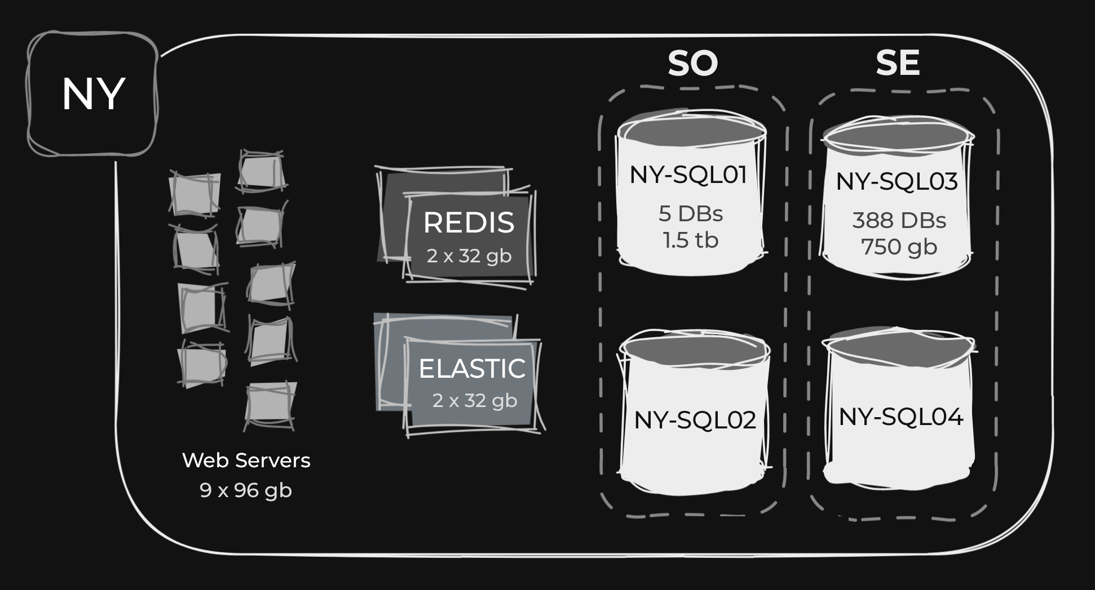

Slide 7
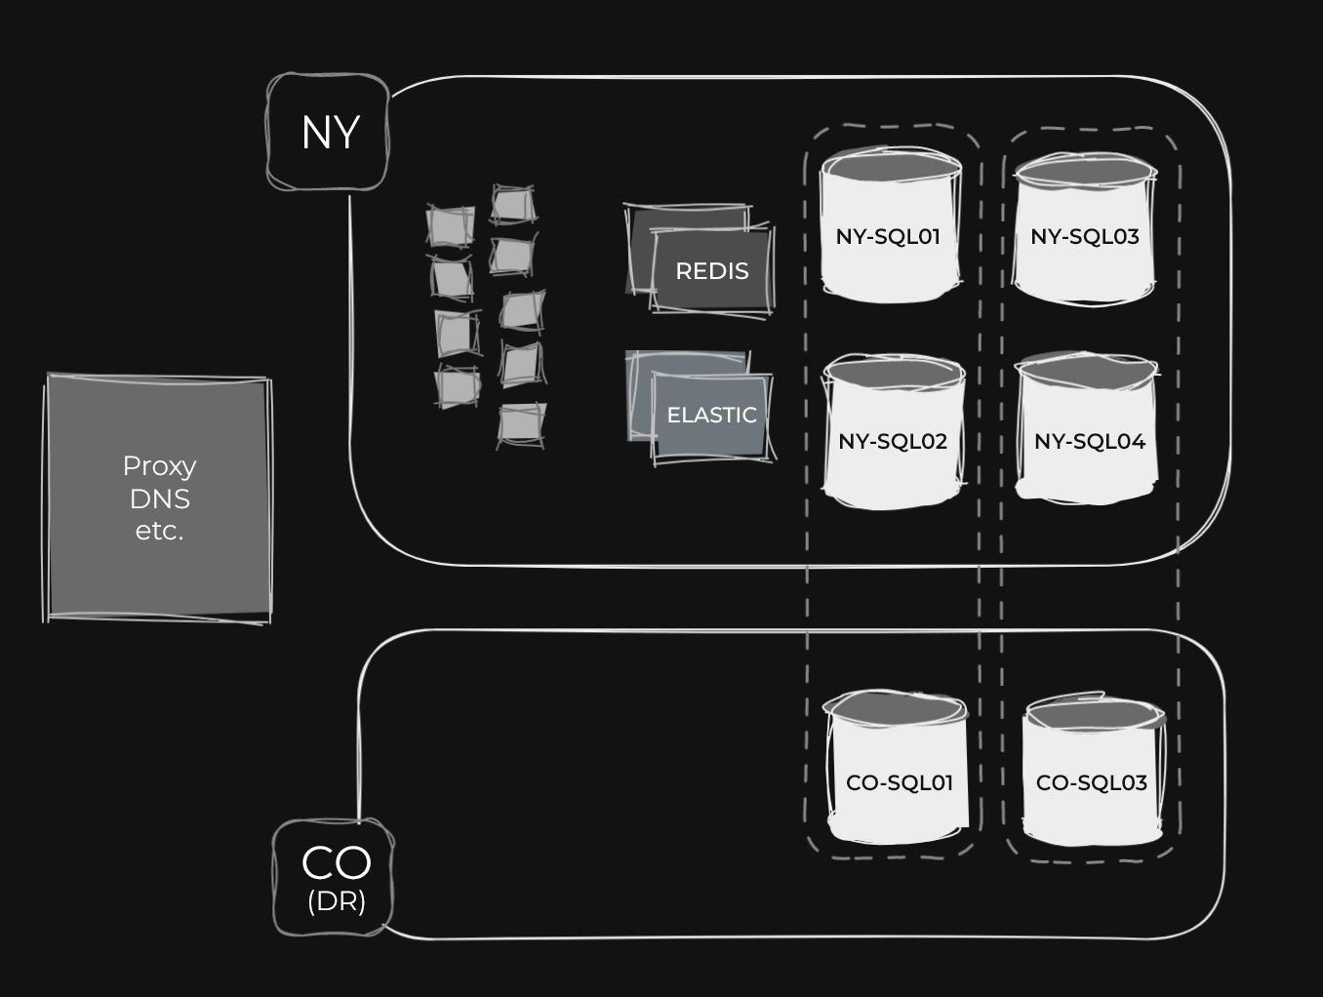

Slide 8
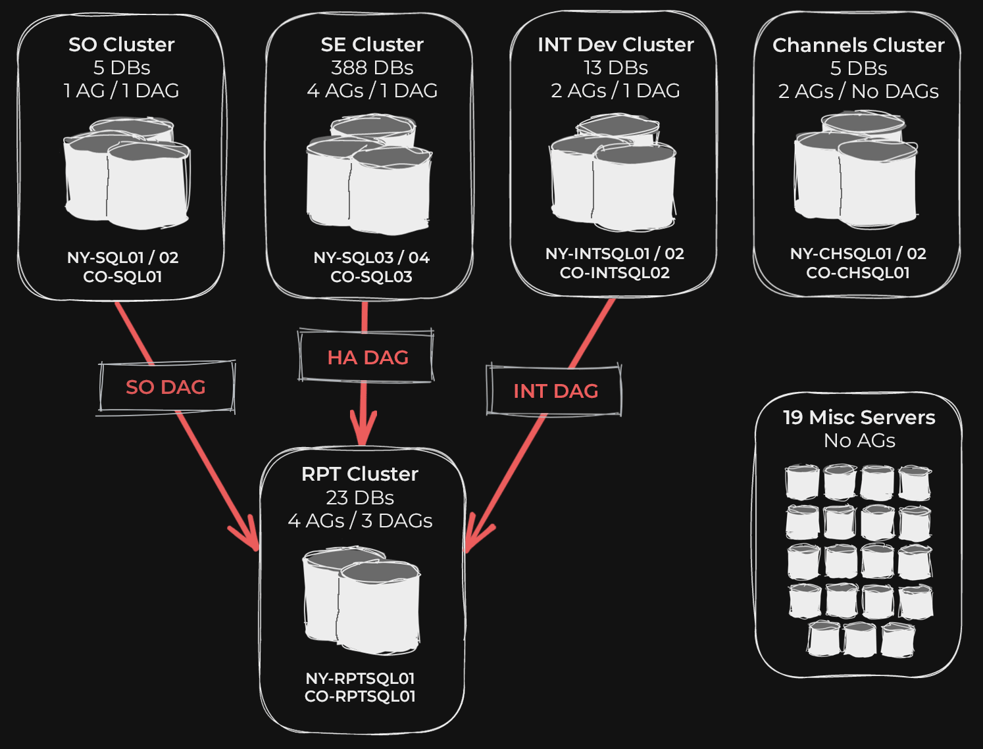

Slide 9
Challenges of Limited Hardware
Need to be mindful of free space
Juggling all the things – using shrinking if needed
Patching and Upgrades can be challenging
All traffic hitting a single server – total user connections
Monitoring and knowing your environment is critical

Slide 10
Observability & Performance
How do we keep the lights on?

Slide 11
Observability Tools

Slide 12
OpServer
(github.com/Opserver)
For what:
High-level and detailed resource usage
Availability Groups configuration and status
Status for other services
Top / active queries
Exceptions
Why? Better visibility than SSMS / SQL Sentry

Slide 13
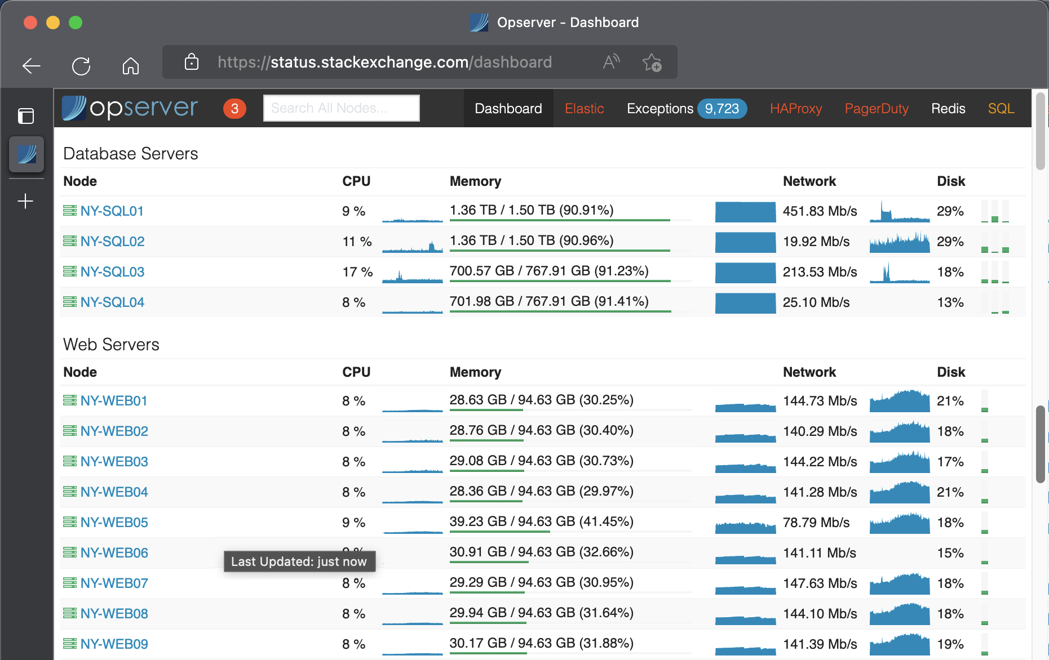

Slide 14
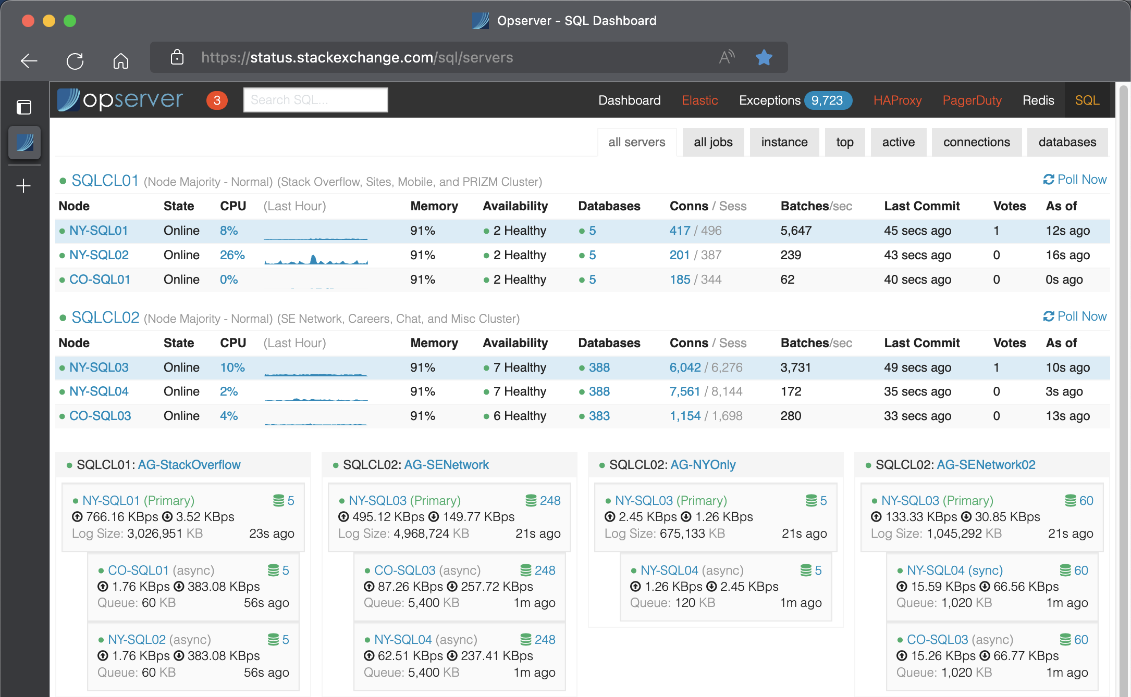

Slide 15
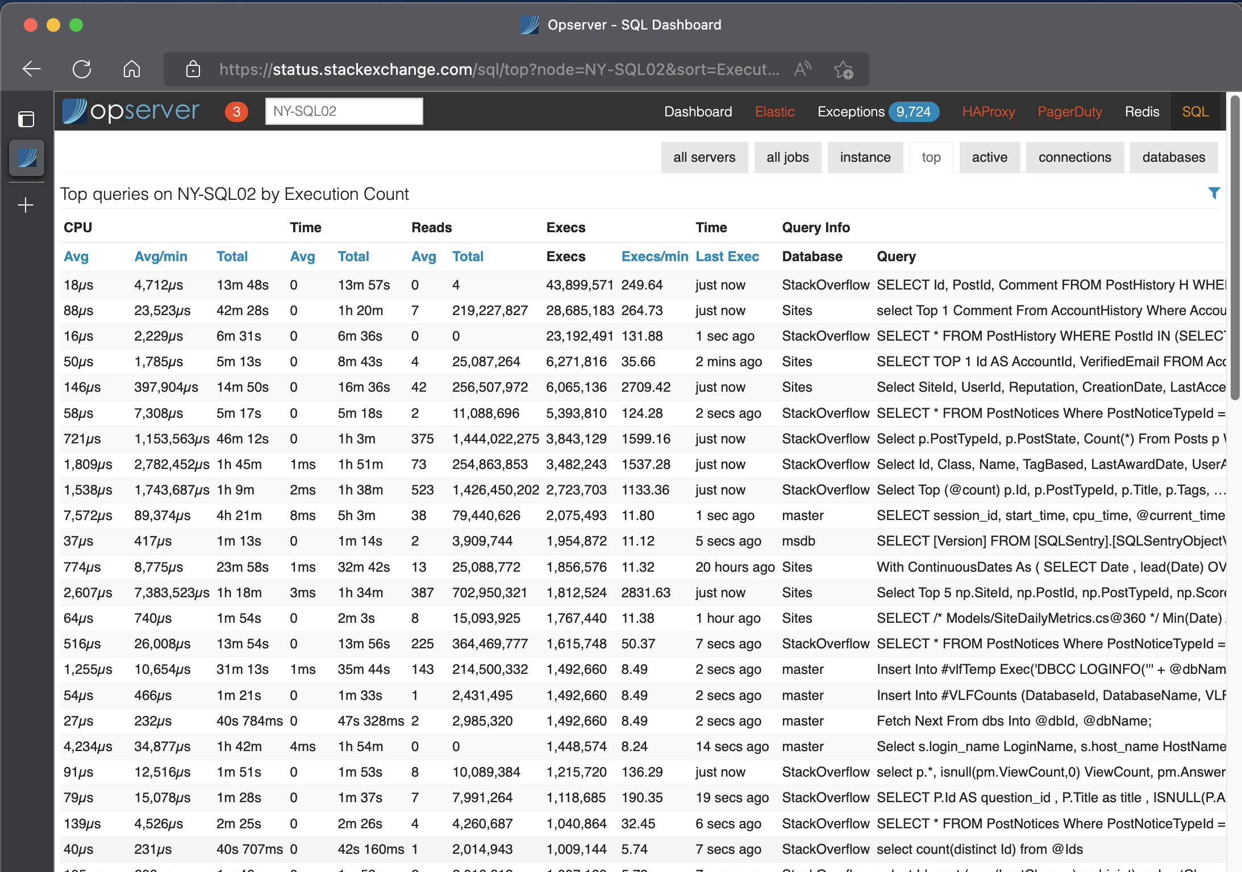

Slide 16
AMtwo’s dba-database
(github.com/amtwo/dba-database)
For what: Availability Group latency and other diagnostics
Why? I’m too lazy to memorize these joins

Slide 17
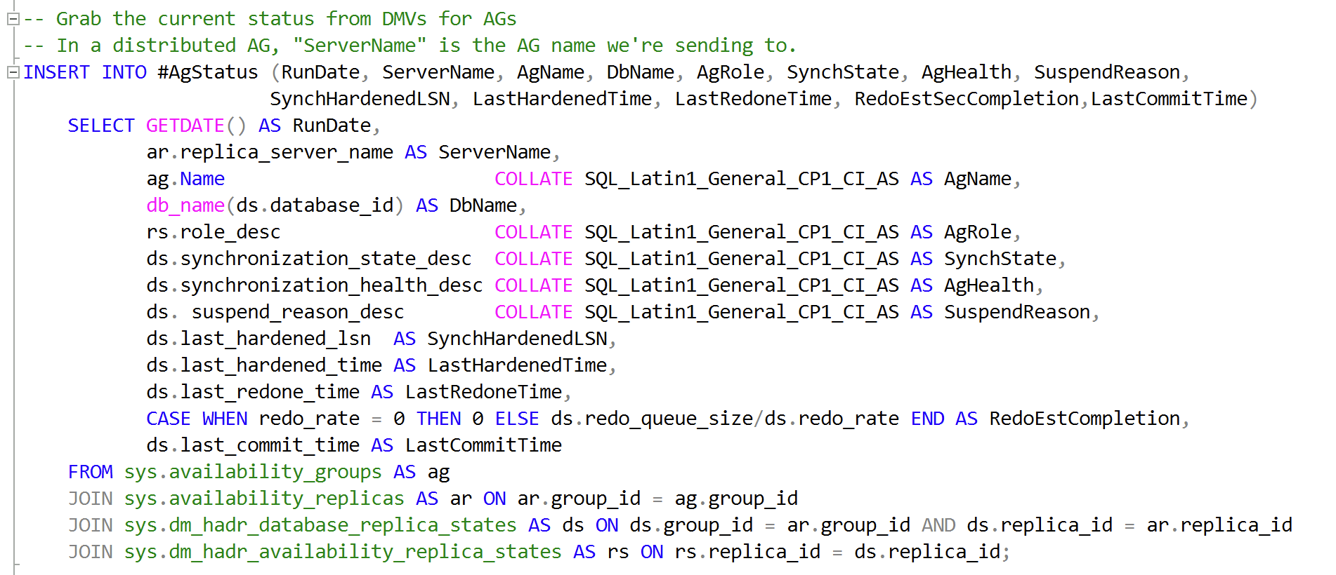

Slide 18
SQL Sentry
(sentryone.com)
For what: actionable alerts, post-incident analysis
Why? highly configurable, great dashboard & drill-through
Downside: Some features not supported (e.g. DAGs)

Slide 19
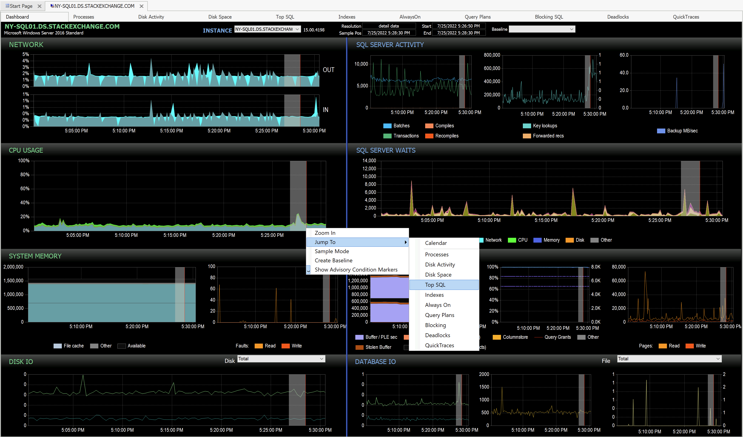

Slide 20
SignalFX
(signalfx.com)
For what: hardware/OS (storage/network), app-specific dashboards
Why? Easy-to-configure dashboards, used wider than just DBRE

Slide 21
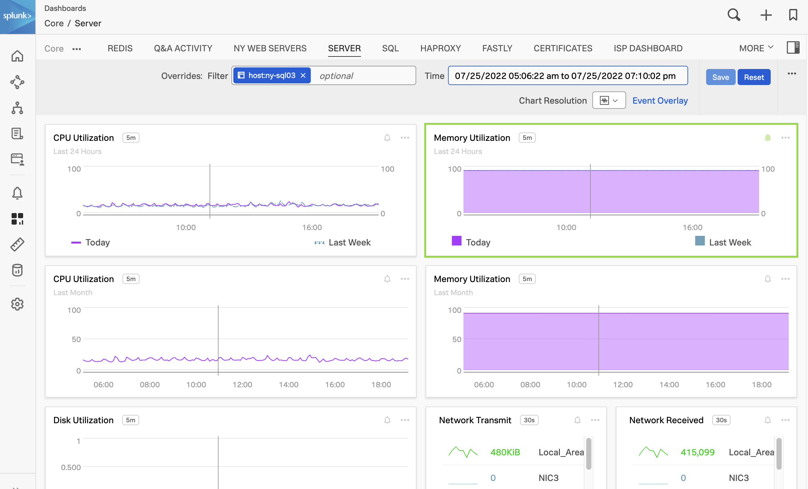

Slide 22
Other Internal Data / Tools
HAProxyLogs
For what? Write traffic data to a database async
Why? To investigate site instability issues

Slide 23
Datadog
(datadoghq.com)
Currently in PoC – primarily to reduce observability sprawl
Already paying off

Slide 24
Minimizing Database Load

Slide 25
Minimizing Database Load
Readable Secondaries
Can be seen as the tempdb (or porta-potty) of your WSFC
“Just throw all read activity at the secondary” only works to a point
Resources and concurrency are limited there, too
Maintaining concurrent versions gets expensive quickly & affect primary/logging
Redis
Mostly for best-effort read caching of things like lists, but not large content like posts
Sometimes to offload writes (e.g. drafts)
Elastic for searches
Things like full-text search can’t solve most searches
We have a lot of custom filters, like is:question, has:answer, etc.
CDN, HAProxy, etc.

Slide 26
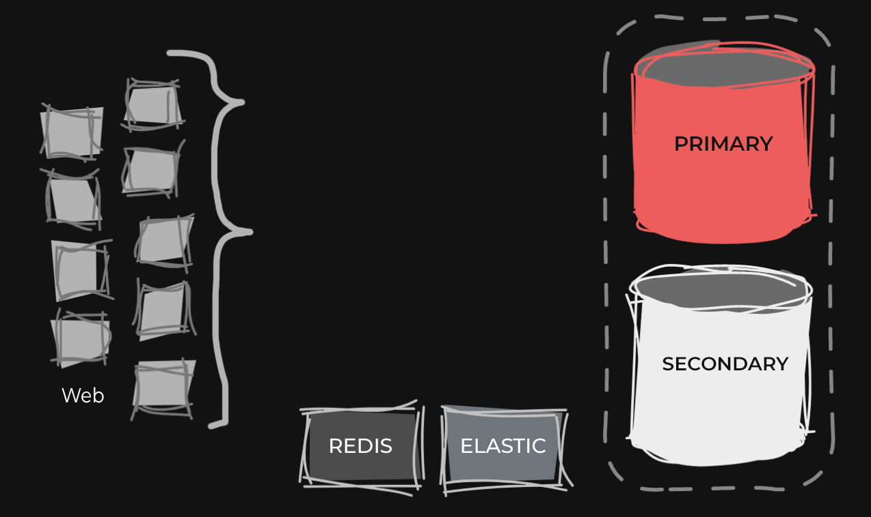

Slide 27
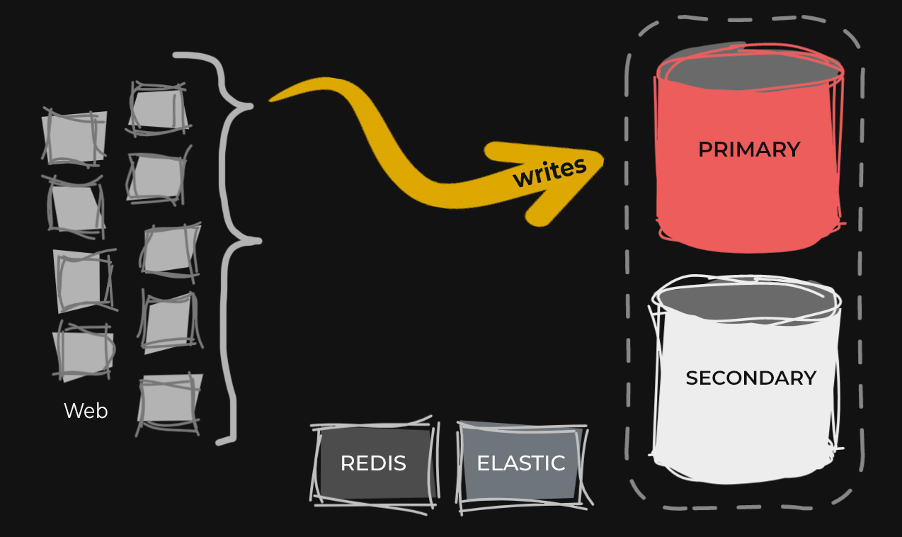

Slide 28
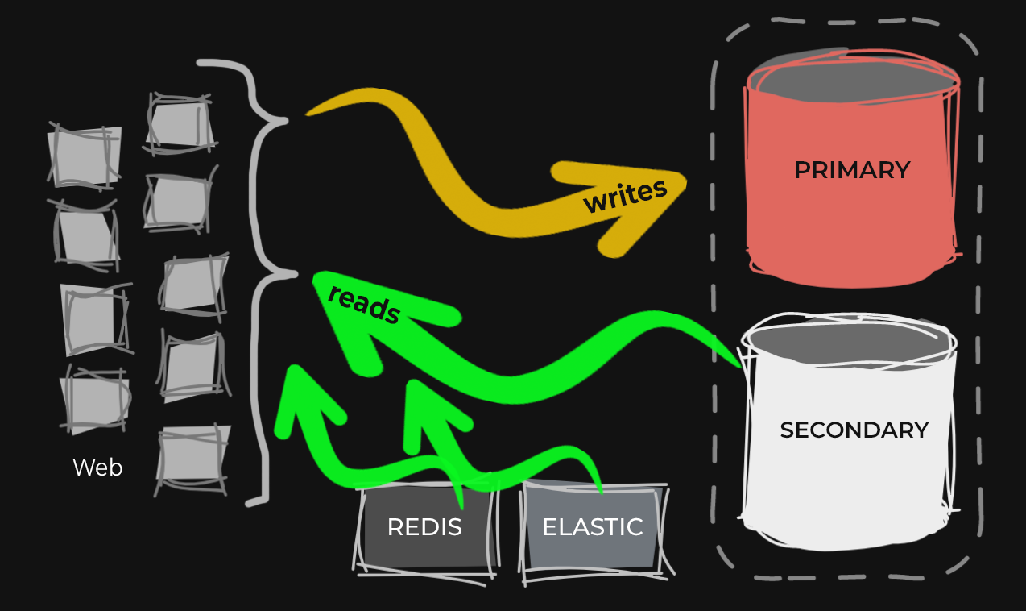

Slide 29
Minimizing Database Load
Readable Secondaries
Redis
Elastic for searches
CDN, HAProxy, etc.
Offload internal analysis to additional copies of the data
and in other forms / systems, e.g. snowflake
Async vs. Sync Secondaries
Trading safety to reduce latency

Slide 30

Other Best Practices We Violate
Schema prefix
App code avoids this to support many tenants
Downside: All tenants fight for slots in plan cache
Stored procedures
We don’t use them (Dapper)
Downside: reduces visibility and control

Slide 31
Can’t Argue With Results
A decade worth of optimizations to minimize page load time
Entire web app for all networks runs on NINE web servers
Consistently <= 10% CPU, 30% of 96GB memory
Page renders average 20ms without caching
Serves 6K requests/sec, 2 billion page views per month
Public network (all sites) runs on TWO primary SQL Server instances
Consistently <= 15% CPU, but all the memories
Notes:
Recent example if time

Slide 32
2 Billion Page Views Per Month @ 20 Milliseconds Each

Slide 33
Can’t Argue With Results
A decade worth of optimizations to minimize page load time
Entire web app for all networks runs on NINE web servers
Public network (all sites) runs on TWO primary SQL Server instances
Performance problems we’re chasing are usually classes of problems
Or simply not related to end users, the application, or volume
Notes:
Recent example if time

Slide 34
Current Failover Kludge

Slide 35
Under Normal Operation
Read/write activity goes to NY web servers
They read or write to or from:
NY primary
NY secondary
NY Redis/Elastic etc.

Slide 36
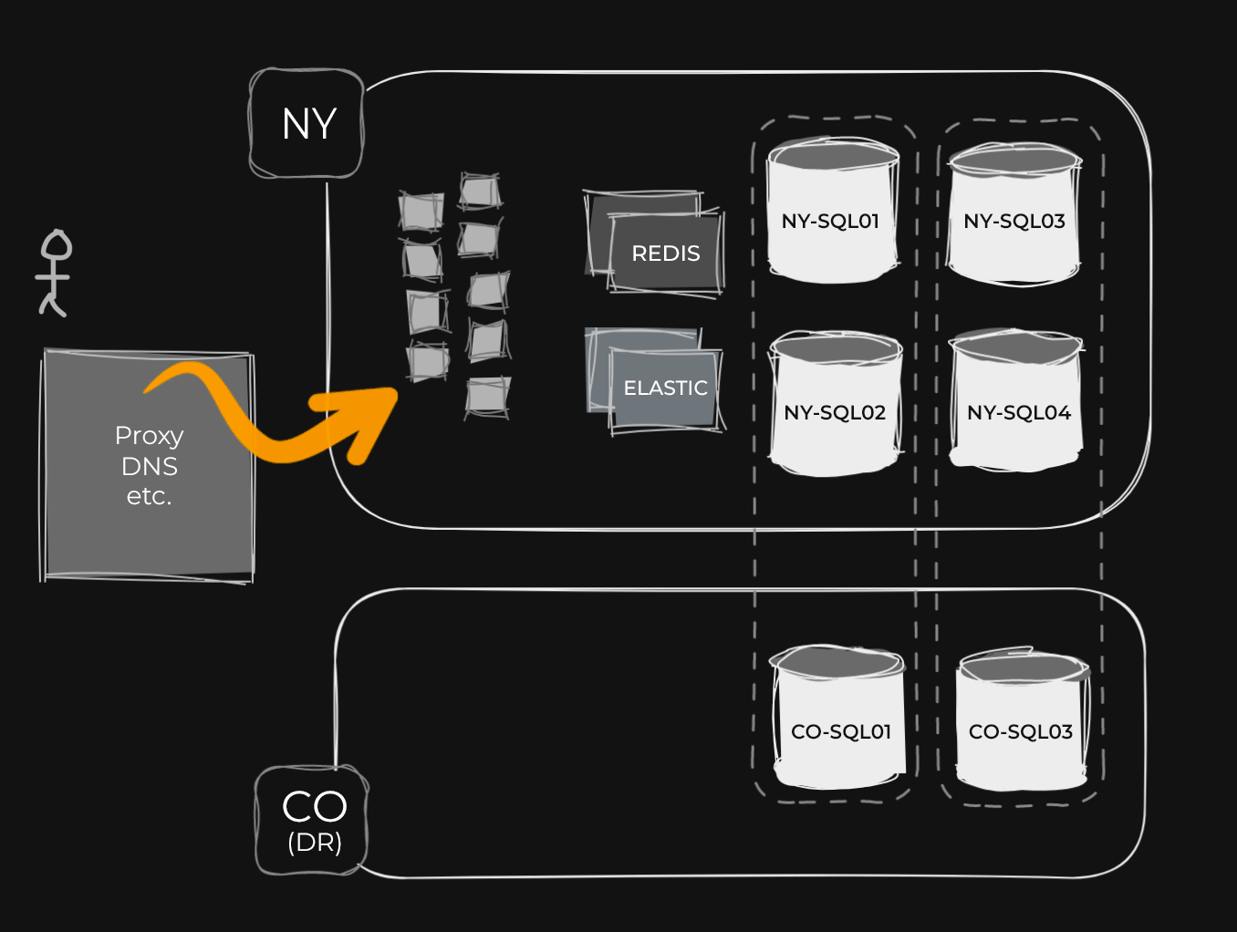

Slide 37
During Patching
We could just point NY web servers to CO secondary

Slide 38
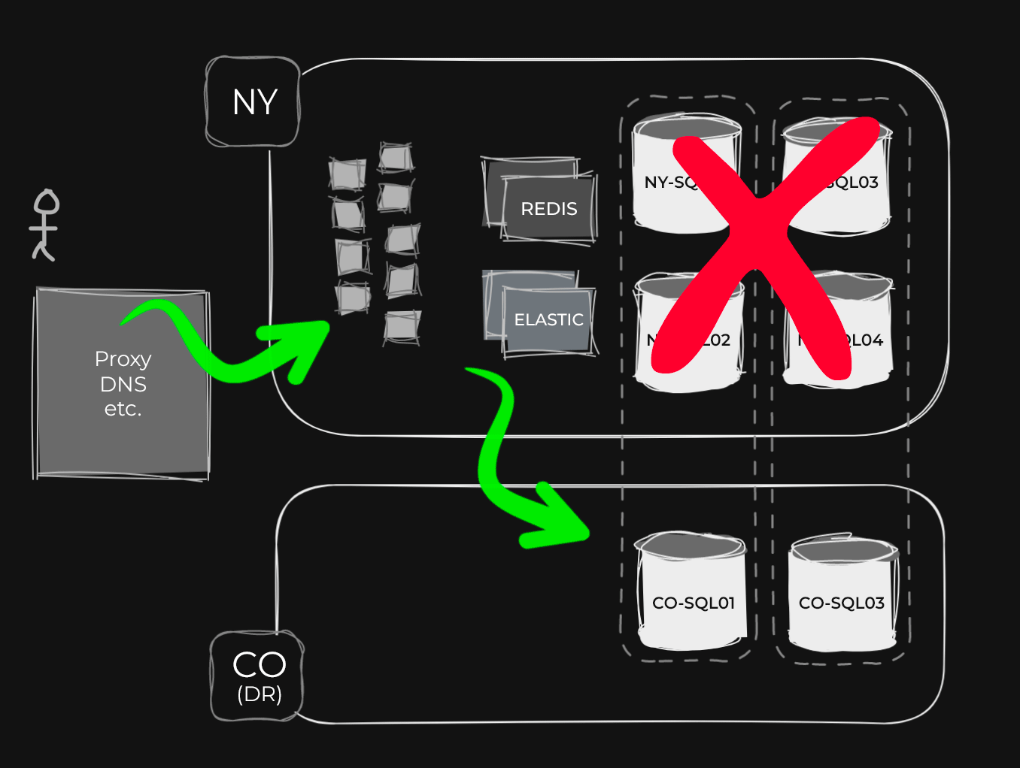

Slide 39
During Patching
We could just point NY web servers to CO secondary
Instead, we fail over the entire architecture
DNS sends requests to CO web servers, which are set to only read from:
CO replica
CO Redis/Elastic etc.

Slide 40
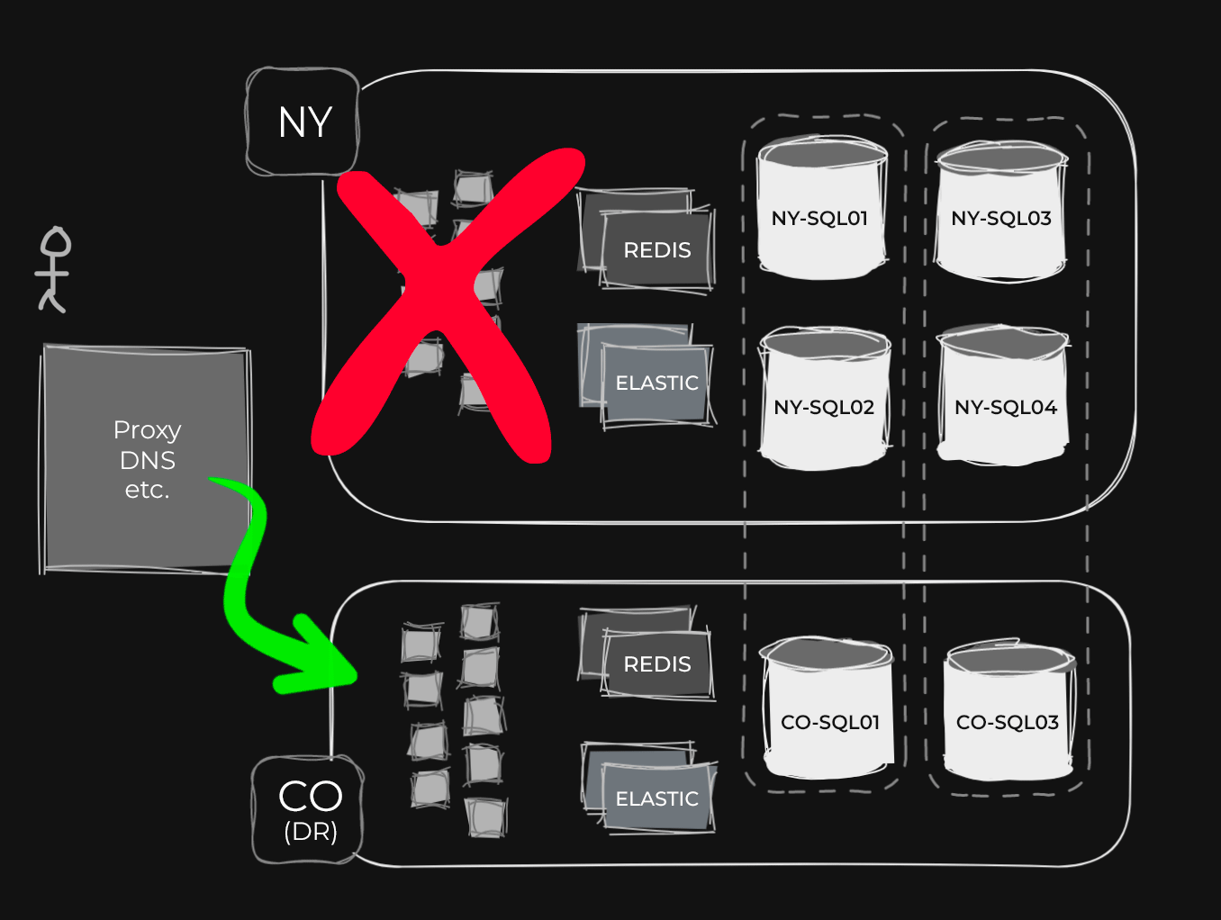

Slide 41
Scalability Problems
How Many Databases Fit in an AG?

Slide 42
What happens when failing over an AG?
Transition Primary to Secondary
Stop allowing writes
Perform recovery to complete rollback or rollforward of all transactions
Begin accepting logs from the new Primary
Transition Secondary to Primary
Ensure transaction logs are completely redone
Begin allowing all transactions, including writes.
Usually all takes less than a minute.

Slide 43
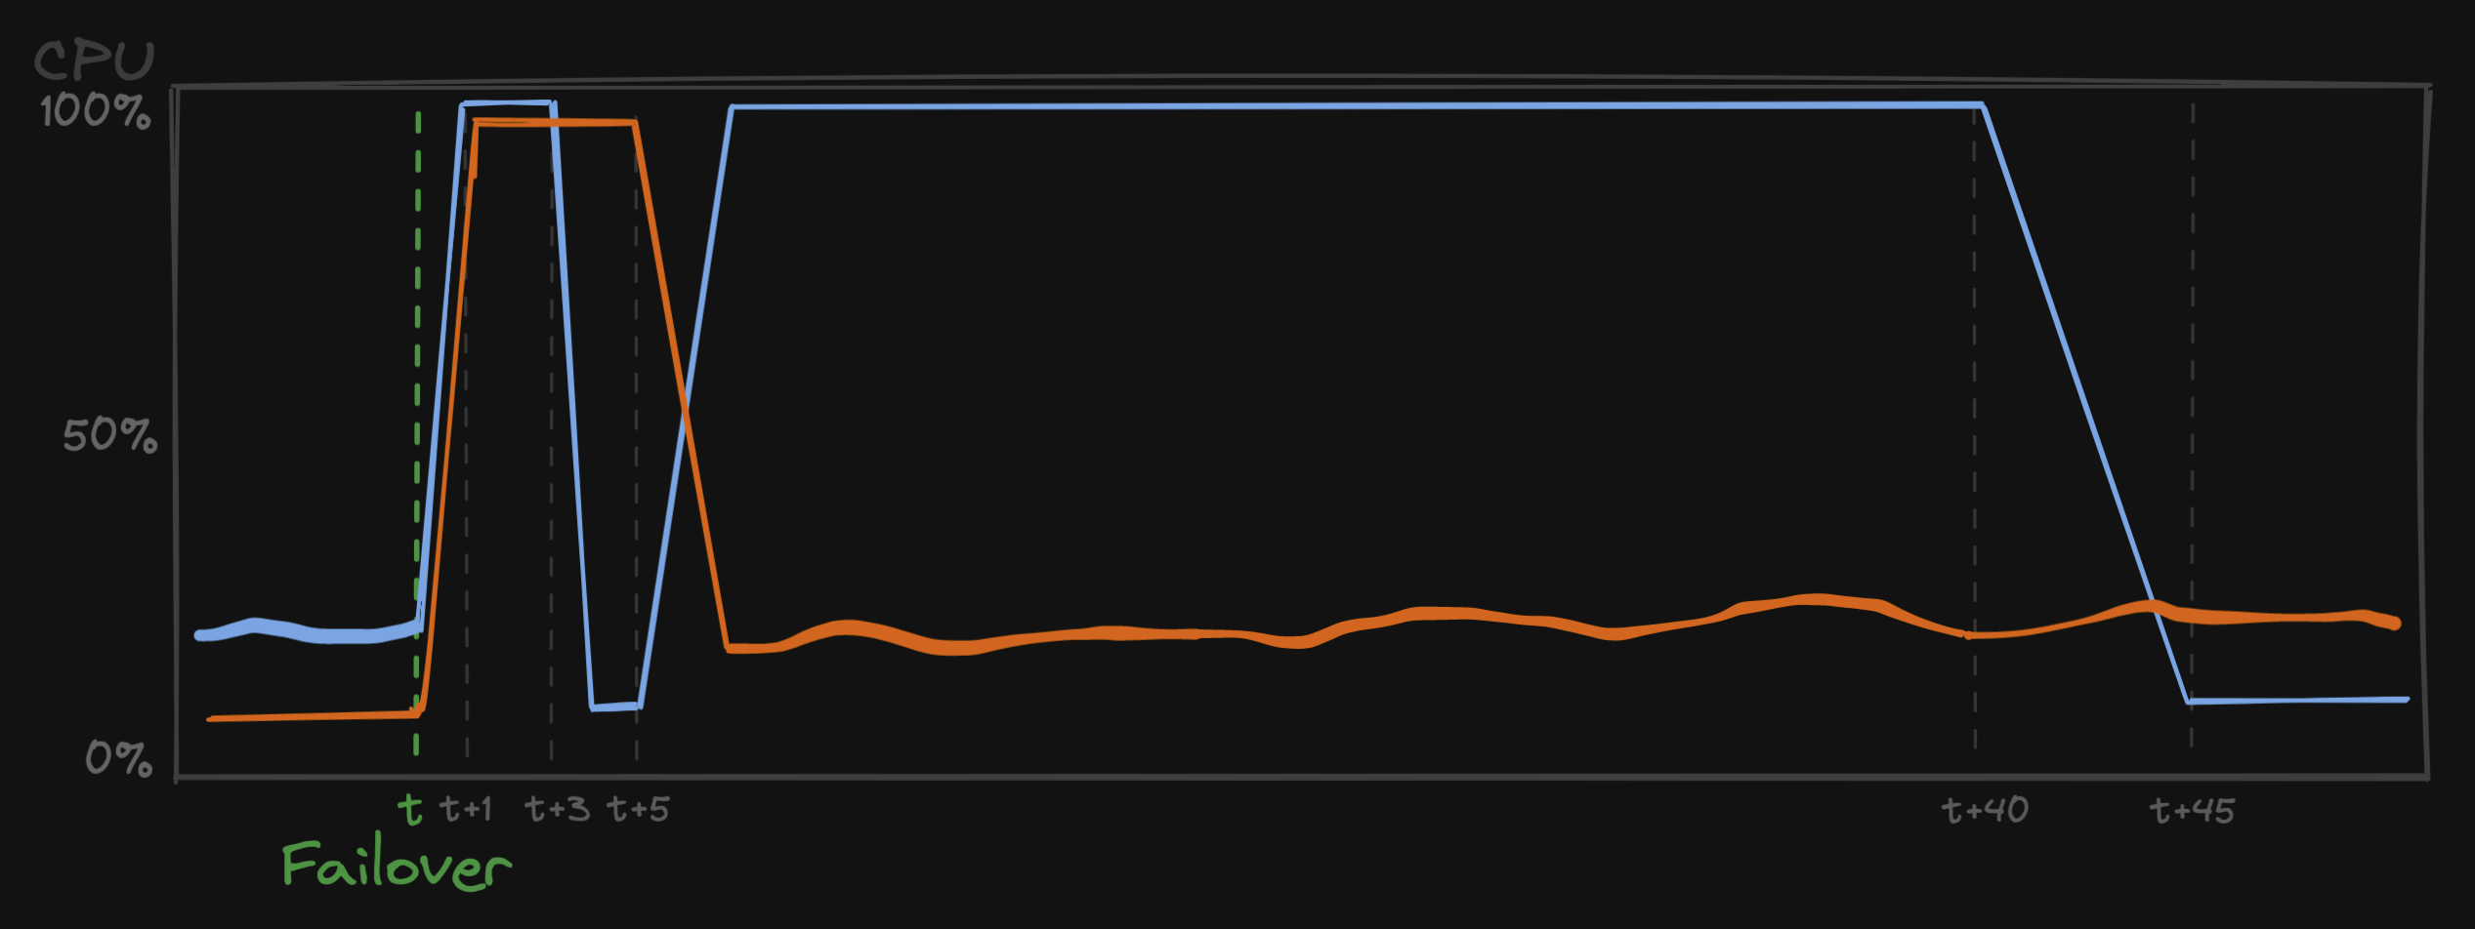

Failing over an AG with 380 databases
CPU on Primary typically about 20%
CPU on read-only Secondary typically about 10%
During failover, CPU on both spikes to 100%

Slide 44
Failing over an AG with 380 databases
During failover, CPU on both spikes to 100%
After a couple of minutes, CPU on the now-former primary finally drops

Slide 45
Failing over an AG with 380 databases
After a couple of minutes, CPU on the now-former primary finally drops
CPU on new primary settles
CPU on former primary back to 100%
Ohno!

Slide 47
Failing over an AG with 380 databases
Transitioning from Primary to Secondary takes ~45 minutes

Slide 48
WTF happened?
This behavior started after our upgrade to SQL Server 2019
No specific change was identified as responsible
Difficult to reproduce
Recovery (rollforward or rollback) of so many databases simultaneously seems to cause thread exhaustion
Even when the databases are not particularly busy

Slide 49
Can we make recovery faster?
Optimize number of Virtual Log Files (VLFs)
Enable indirect checkpoint
Enable Accelerated Database Recovery (ADR)
We could add more cores, except
We’re running on physical boxes
CPU Utilization is low when we aren’t doing a failover
SQL Server Enterprise Edition licensing is not cheap

Slide 50


Slide 51
Break up one large AG into several smaller AGs
Planned failovers can be done serially, and prevent CPU exhaustion
Moving a database between AGs on the same server is straightforward; does NOT require re-initialization
Pause log backups
[Primary] ALTER AVAILABILITY GROUP AG-1 REMOVE DATABASE MyDB;
Wait for secondaries to reflect the change
[Primary] ALTER AVAILABILITY GROUP AG-2 ADD DATABASE MyDB;
[Secondary] ALTER DATABASE MyDB SET HADR AVAILABILITY GROUP = AG-2;
Resume log backups
Repeat for every database (or automate it)

Slide 52
How many databases fit in an AG??
The maximum number of databases in an AG is “unlimited”
Up to the 32,767 database per instance limit
Microsoft recommends no more than 100 databases in an AG
All their test cases are built around a 100 database max
Azure SQL Managed Instance enforces 100 database limit
If you care about high availability, don’t put more than 100 databases in any AG

Slide 53
Making disruptive DDL & DML changes
…and making them less disruptive

Slide 54
Disruptive DML & DDL changes on an AG
All changes are written to the transaction log
on Primary & Secondaries
If a replica is synchronous commit the change is written to that transaction log before it’s considered committed.
Data is changed on Primary as part of the DML/DDL “like normal”
Change is redone from the secondary asynchronously
REDO IS ALWAYS ASYNC, even on synchronous replicas
Readable secondaries always use Snapshot so Reads don’t block writes
DDL still needs (blocking) schema stability locks

Slide 55
The time Andy broke Stackoverflow.com
During a maintenance window, the site was in read-only & pointed at a readable secondary & web servers in our DR location.
I was running DDL to remove SPARSE columns from some very large, very busy tables
Redo on the secondary began blocking….everyone
[Secondary] ALTER DATABASE MyDB SET HADR SUSPEND;
Make change
Move traffic back to Primary
[Secondary] ALTER DATABASE MyDB SET HADR RESUME;

Slide 56
Ask Us Anything
Or we’ll just chit-chat

Slide 57
Taryn Pratt / Andy Mallon / Aaron Bertrand
EightKB : 2022-08-03

